Slide 1
JIBEBE MECHANICAL WEEK 6
Ian Mutisya

Slide 2
TASKS COMPLETED THIS WEEK
Selection of motor for hydraulic pump albeit pending calculations (will be done in consultation with electrical team).
Design of new steering system
Final dimensioning and design of flywheel coupling
Improvement of 3D model

Slide 3
HYDRAULIC PUMP MOTOR SPECIFICATIONS
We researched and found that a similar electric hydraulic pump of same capacity uses a 60W 12V motor,hence our choice power is a 70W one so as to accommodate the different implements to be used

Slide 4
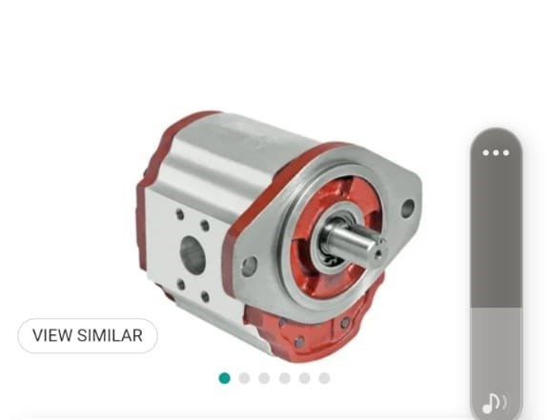
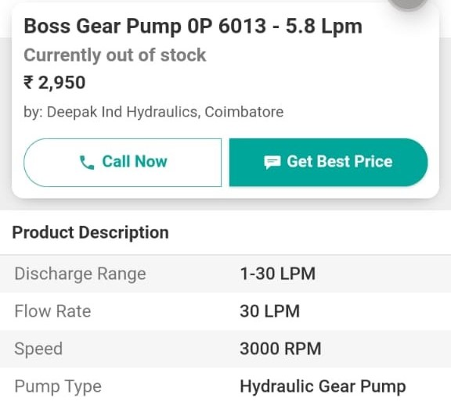

Slide 5
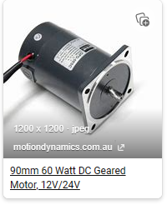
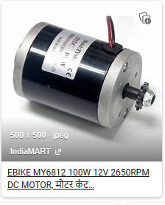

Slide 6
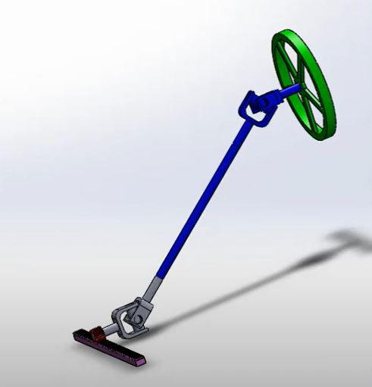
STEERING DESIGN

Slide 7
WHY A NEW DESIGN?
The other steering had play leading to over steering and under steering
The battery size does not leave enough space for the previous model
The rack and pinion design allows for easier rotation of the steering wheel

Slide 8
TO DO
Outsourcing the motor flywheel coupling
Hydraulic pump motor acquisition
Steering design and fabrication

Slide 9
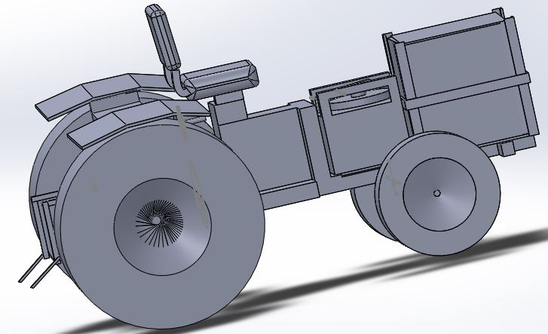
3D REPRESENTATION

